Slide 1
SMART GARBAGE SYSTEM
BY:
PRERIT AGRAWAL(18BLC1156)
ABHYUDAY MANDLOI SINGH(18BLC1159)
TEJAS MUNDADA (18BLC1154)

Slide 2
OBJECTIVE
Objective of the project is collection of the garbage in the efficient way. Due to the overflow and improper disposal of the garbage we face any problems. So to overcome such type of problems the Smart Garbage System is designed . The Smart Garbage System intend to control the Gabage and not let it overflow out into the surrounding.

Slide 3
EMBEDDED SYSTEM PROCESS

Slide 4
PURPOSE:
The proposed system is much more efficient than any other conventional system as it
reduces the use of manpower, avoids spillover of waste, saves time,
more economical, and most importantly it is a completely automated system.
INPUT:
PIR for motion detection and ultrasonic sensor for measuring distance for throwing garbage in the bin
OUTPUT:
Status of the garbage bin is displayed on the webpage and also a mail is sent to the municipal
corporation regarding it.

Slide 5
Function of the system
In this Project, an Ultrasonic Sensor is used for detecting whether the trash can is filled with garbage or not.
Ultrasonic Sensor is installed at the top of Trash Can and will measure the distance of garbage from the top of Trash can
We will set a threshold value according to the size of trash can.
If the distance will be less than this threshold value, means that the Trash can is full of garbage and we will print the message “Basket is Full”
If the distance will be more than this threshold value, then we will print the message “Basket is Empty”.
We will use Wi-Fi module for connecting the Arduino to the Garbage collector.

Slide 6
Design Metrics
Power dissipation: As required by mechanical units, display units and computer system.
Performance:[Assumed] Alert message when more than 50% used.
Process Deadlines: As soon as the garbage bin is full and that time it takes to get full is the overall process time.
User Interface: Display of the message on the webpage and also on mail id.
Engineering Cost: Around Rs.3000-5000
Manufacturing cost: Around Rs. 2000

Slide 7
Specifications
Ultrasonic sensor: This is use to measure the distance of garbage from Top of can
Wi-Fi Module : This will be used to send the message to the Garbage collector if the bin is full.
PIR Sensor : When someone comes near the bin it opens automatically.

Slide 8
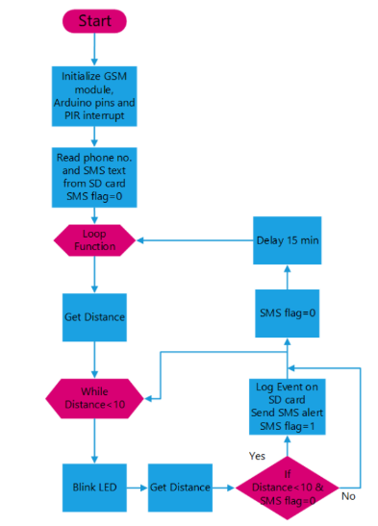
ARCHITECTURE DIAGRAM

Slide 9
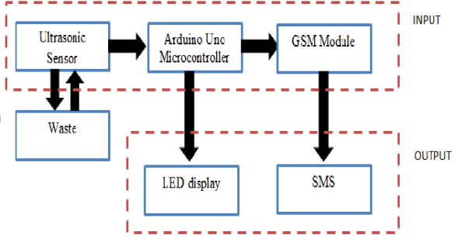
HARDWARE ARCHITECTURE

Slide 10
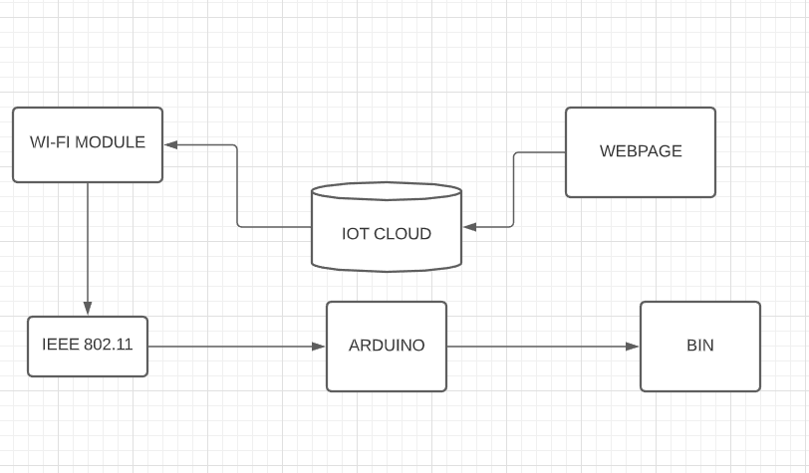
SOFTWARE REQUIREMENTS

Slide 11
TOOLS REQUIRED
ARDUINO
ULTRASONIC SENSOR
PIR SENSOR
WIFI MODULE
BREADBOARD
RESISTORS
CONNECTING WIRES
SERVO MOTOR

Slide 12
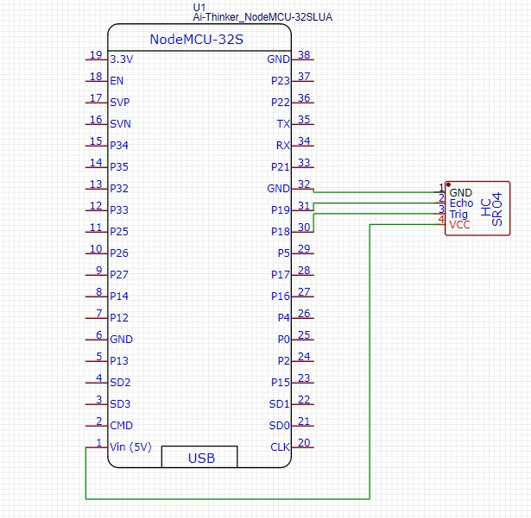
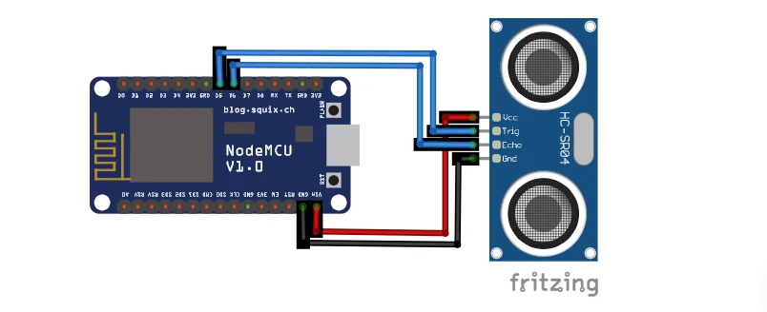
SCHEMATIC DESIGN

Slide 13
ALGORITHM –UML FORMATS

Slide 14
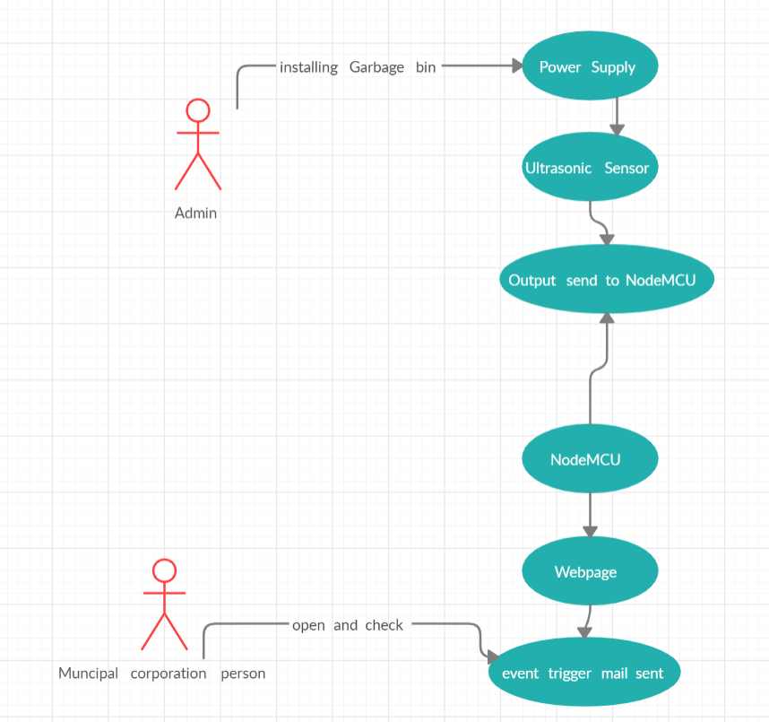
USE CASE DIAGRAM

Slide 15
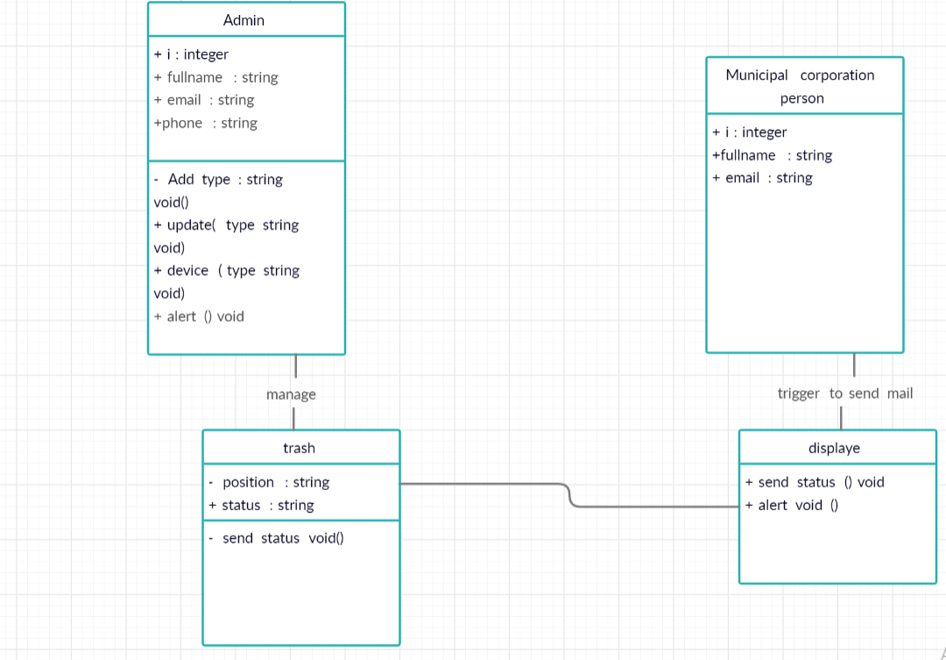
CLASS DIAGRAM

Slide 16
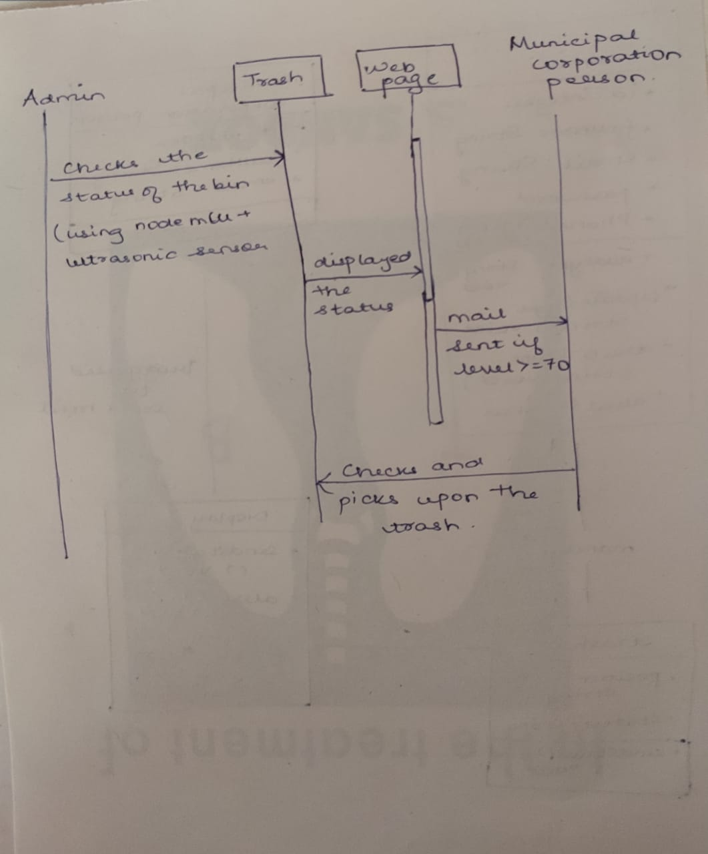
SEQUENCE DIAGRAM

Slide 17
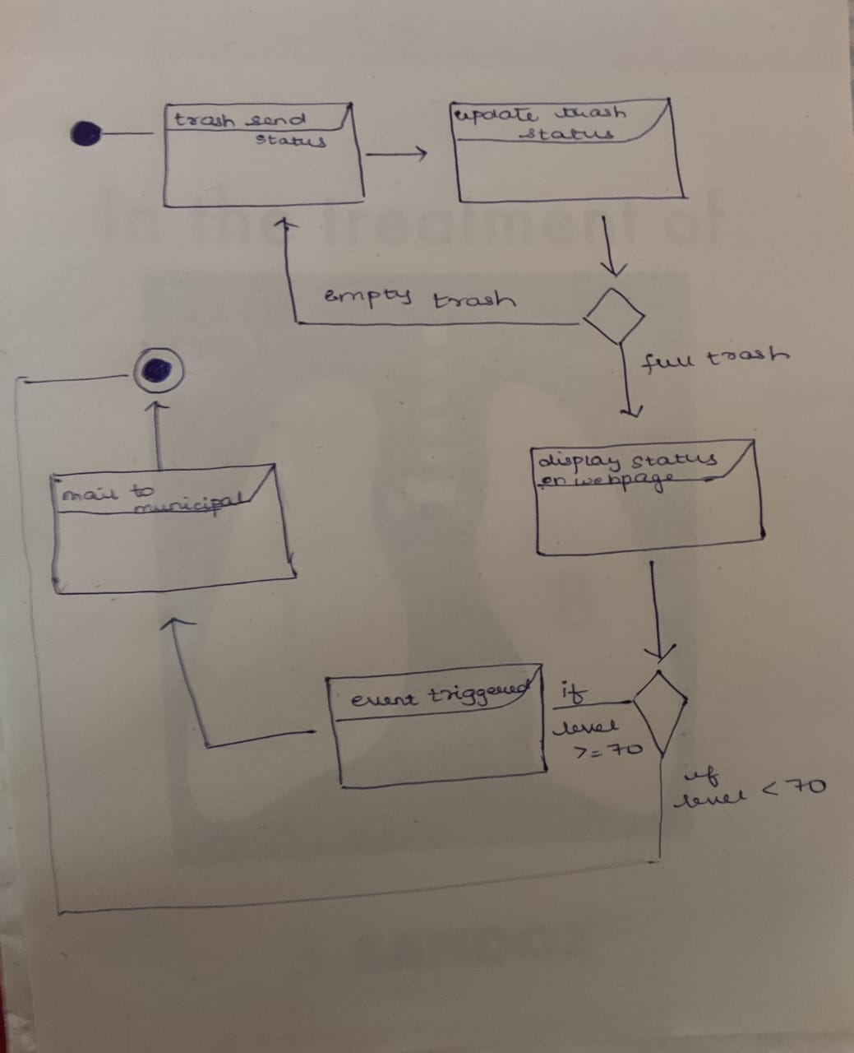
STATE TRANSITION STATE

Slide 18
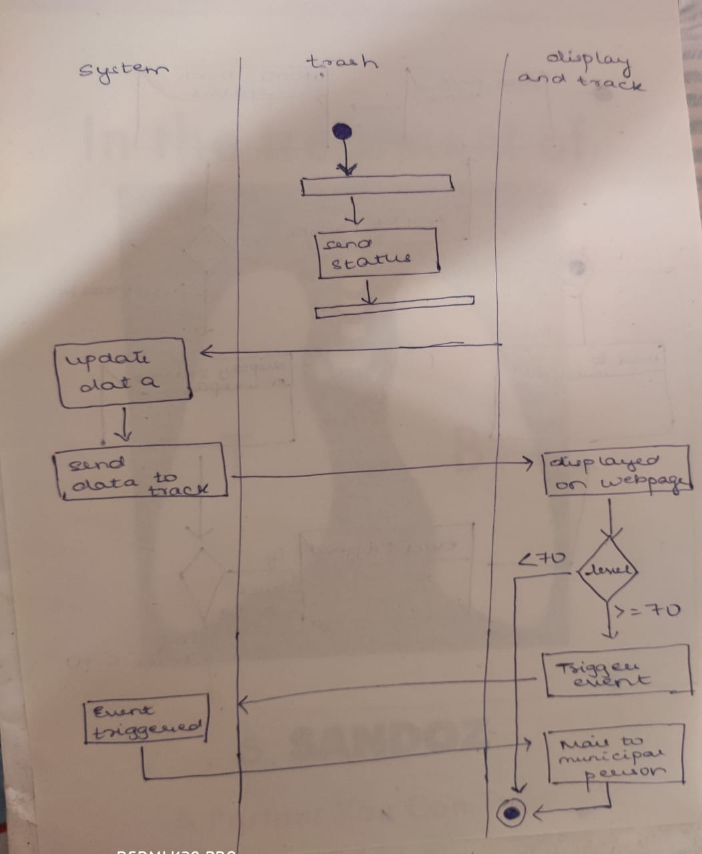
ACTIVITY DIAGRAM

Slide 19
CODE:
#include <ESP8266WiFi.h>
const int trigPin = D5;
const int echoPin = D6;long duration;int distance;
void send_event(const char *event);
long level;const char* ssid = "DESKTOP-F8HVJ1S 7597";
const char* password = "prerit10";
const char *host = "maker.ifttt.com";
const char *privateKey = "kBfpizel9dhMWcI3C6bg0LShw6Epe-M4nyw6E0vB2dN";
WiFiServer server(80);

Slide 20
void setup()
{ pinMode(trigPin, OUTPUT);
pinMode(echoPin, INPUT);
Serial.begin(9600);
Serial.print("Connecting to Wifi Network");
Serial.println(ssid);
WiFi.begin(ssid, password);
while (WiFi.status() != WL_CONNECTED) {delay(500);Serial.print(".");}

Slide 21
Serial.println("");
Serial.println("Successfully connected to WiFi.");
Serial.println("IP address is : ");
Serial.println(WiFi.localIP());server.begin();Serial.println("Server started");}
void loop()
{
digitalWrite(trigPin, LOW);
delayMicroseconds(2);
digitalWrite(trigPin, HIGH);
delayMicroseconds(10);

Slide 22
digitalWrite(trigPin, LOW);
duration = pulseIn(echoPin, HIGH);
distance = duration * 0.0340 /2;Serial.println("Distance");Serial.println(distance);level =((25 -distance)/25.0)*100;Serial.println("level");Serial.println(level);delay(1000);

Slide 23
WiFiClient client = server.available();
if (client){Serial.println("Web Client connected ");
String request = client.readStringUntil('\r’);
client.println("HTTP/1.1 200 OK");
client.println("Content-Type: text/html");
client.println("Connection: close"); // the connection will be closed after completion of the responseclient.println("Refresh: 10"); // update the page after 10 sec
client.println();client.println("<!DOCTYPE HTML>");client.println("<html>");

Slide 24
client.println("<style>html {
font-family: Cairo; display: block; margin: 0px auto;
text-align: center;color: #333333; background-color: ##f3ffee;}");client.println("body{margin-top: 50px;}");
client.println("h1 {margin: 50px auto 30px; font-size: 50px; text-align: center;}");
client.println(".side_adjust{display: inline-block;vertical-align: middle;position: relative;}");
client.println(".text1{font-weight: 180; padding-left: 5px; font-size: 50px; width: 170px; text-align: left; color: #3498db;}");
client.println(".data1{font-weight: 180; padding-left: 1px; font-size: 50px;color: #3498db;}");client.println(".data{padding: 1px;}");client.println("</style>");client.println("</head>");client.println("<body>");client.println("<div id=\"webpage\">");client.println("<h1>IoT Based Dustbin</h1>");

Slide 25
client.println("<div class=\"data\">");
client.println("<div class=\"side_adjust text1\">Status:</div>");
client.println("<div class=\"side_adjust data1\">");client.print(level);client.println("<div class=\"side_adjust text1\">% filled</div>");
client.println("</div>");client.println("</div>");
client.println("</body>");client.println("</html>");//
client.println("<h1>Level Indicator</h1>");if ( level >= 70) {send_event("dustbin_event");}}}void send_event(const char *event){
Serial.print("Connecting to ");Serial.println(host);// Use WiFiClient class to create TCP connectionsWiFiClient client;const int httpPort = 80;if (!client.connect(host, httpPort))

Slide 26
{Serial.println("Connection failed");return;}// We now create a URI
for the requestString url = "/trigger/";url += event;url += "/with/key/";url += privateKey;
Serial.print("Requesting URL: ");
Serial.println(url);// This will send the request to the server
client.print(String("GET ") + url + " HTTP/1.1\r\n" +"Host: " + host + "\r\n" +"Connection: close\r\n\r\n");
while(client.connected()){if(client.available())
{
String line = client.readStringUntil('\r');Serial.print(line);}
else {// No data yet, wait a bitdelay(50);};}

Slide 27
SERVO MOTOR AND PIR SENSOR
#include <Servo.h>
Servo myservo;int pos=0;
void setup(){pinMode(7, INPUT);
myservo.attach(11);myservo.write(0); }
void loop()
{ if(digitalRead(7)==HIGH)
{ for(pos=0;pos<=90;pos+=1)
{ myservo.write(pos); delay(10); }
delay(5000); } else { myservo.write(0); }}

Slide 28
OUTPUTS

Slide 29
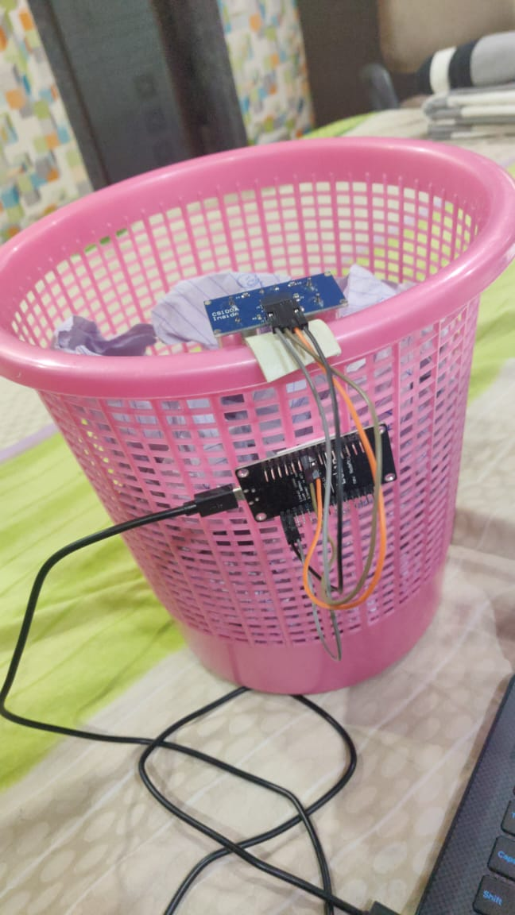
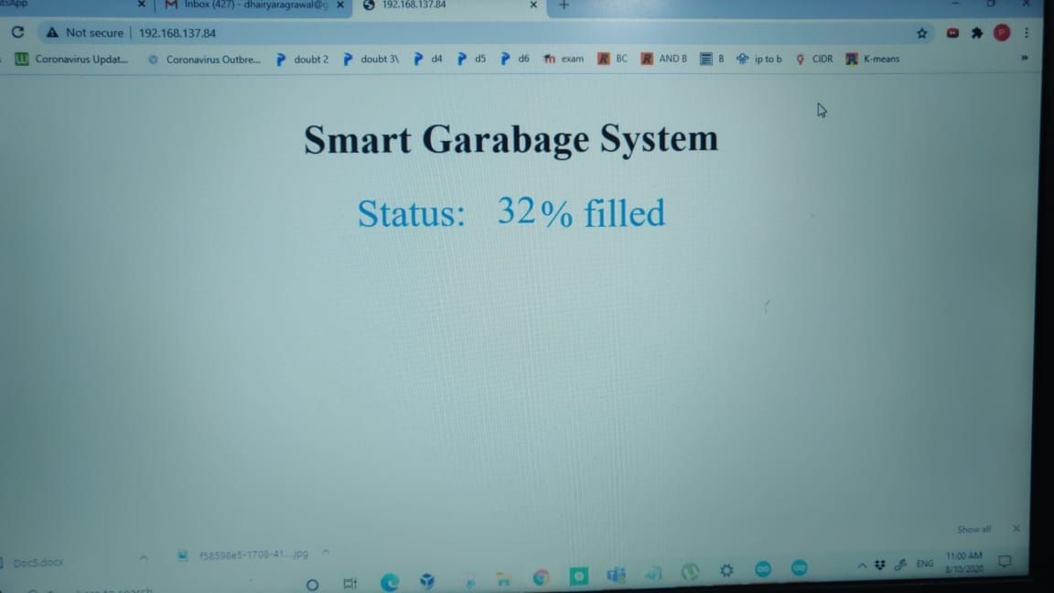

Slide 30
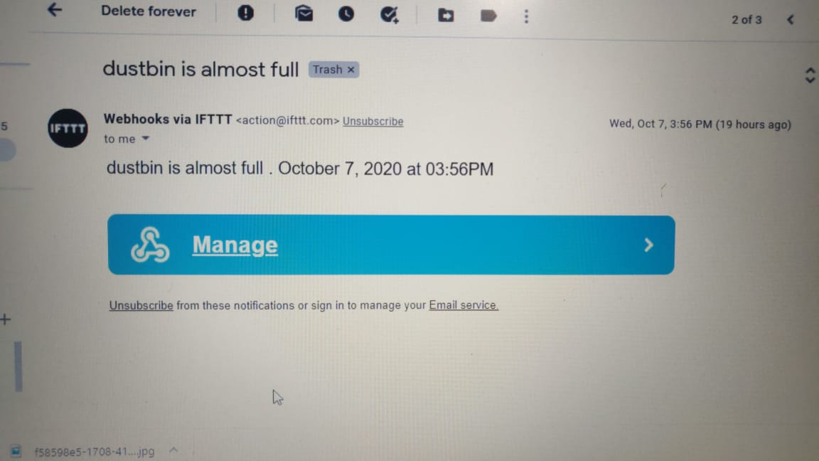

Slide 31
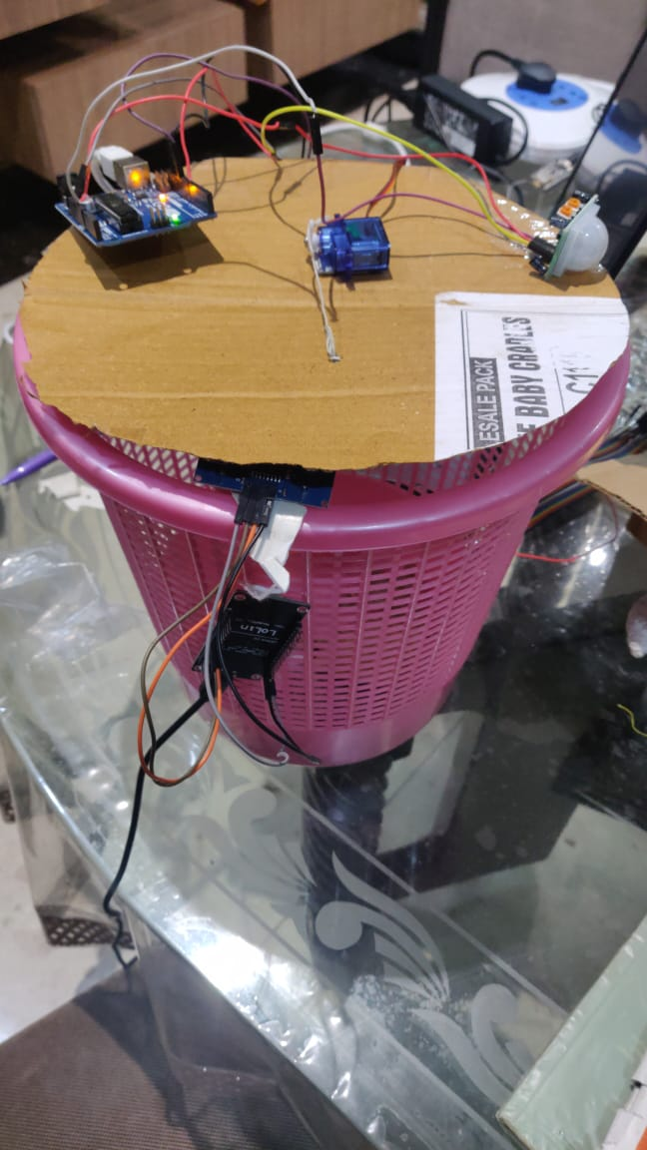
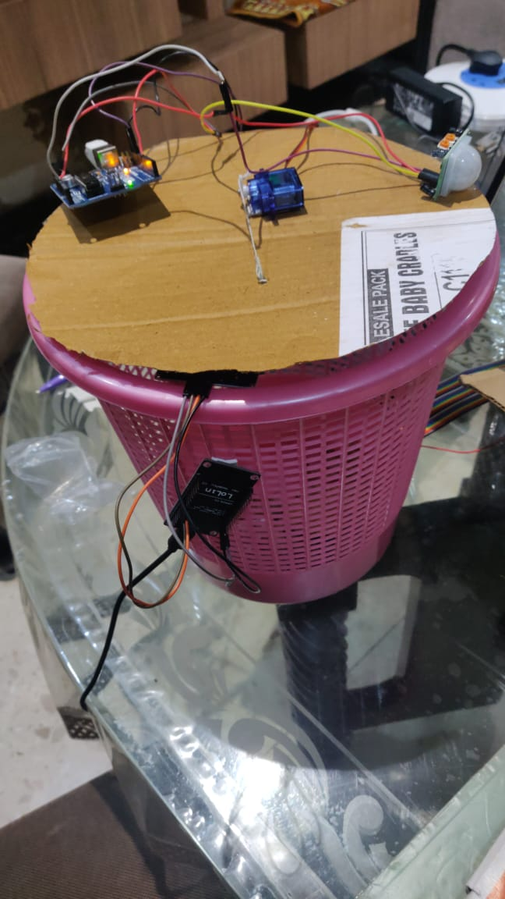
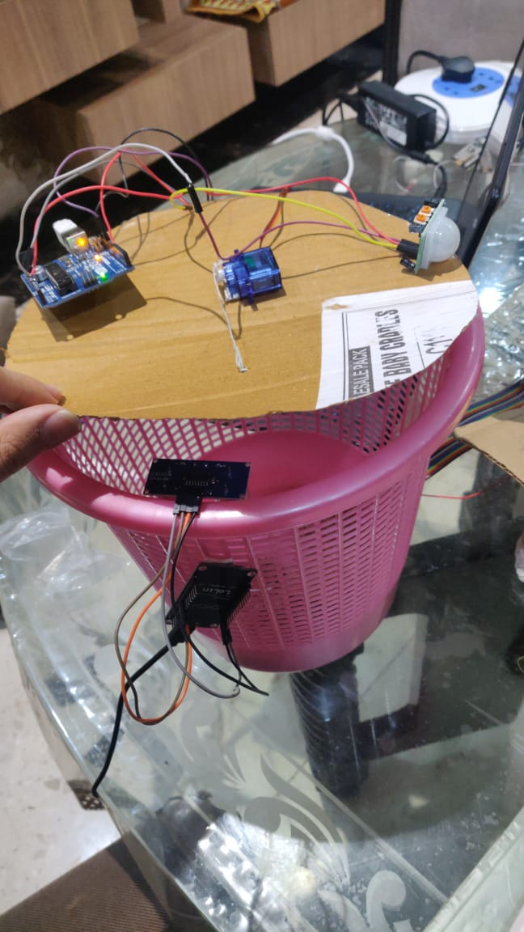

Slide 32
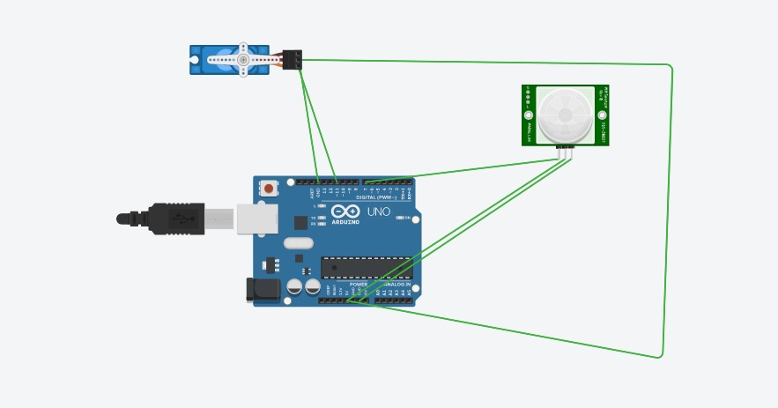
PCB DESIGN

Slide 33
COST ANALYSIS
Arduino spare so we won't include it's cost
Node mcu Rs.400
Ultrasonic Rs.200
Wires ,jumper wires Rs.100
Pir Rs.200
Motor Rs.200

Slide 34
APPLICATIONS
Similar applications that are related to the making of the project are:
Smart City system.
Waste management System
Smart Packaging Systems
Differentiating dry and wet garbage

